Slide 1



CMR TECHNICAL CAMPUS UGC (Autonomous) Kandlakoya, Medchal Road, Hyd-501 401 Department of Computer Science and Engineering Major Project Review
DETECTION OF PHISHING WEBSITE USING SVM
AND LIGHT GBM ALGORITHM
Batch no:09
Project Coordinator:
Dr. J. Narsimharao
(Associate Professor)
Under the guidance:
A. Kiran Kumar
(Assistant Professor)
Presented By:
B.Bhavya Sri (227R5A0524) D.Vamshi (217R1A05M1) T.Vishwa Teja (217R1A05R2)

Slide 2
ABSTRACT
Phishing attacks are a common method for stealing sensitive user information, such as passwords and financial details. As phishing techniques evolve, cybersecurity professionals seek more effective detection methods. This project uses machine learning to identify phishing URLs by analyzing domain-based and structural features.
The system employs Decision Tree, Random Forest, SVM, and LightGBM, with LightGBM enhancing accuracy and speed. By combining multiple models, it improves reliability, reduces false positives, and enables real-time detection, making it a robust solution against phishing threats.

Slide 3
EXISTING SYSTEM
Blacklist-based detection maintains a database of known phishing websites. When a user visits a site, its URL is compared against the blacklist. If the URL is found in the database, the website is flagged as phishing.
Data Sources for Blacklists : Blacklists are updated using reports from users, cybersecurity organizations, and automated web crawlers that identify phishing sites. Common blacklists include Google's Safe Browsing and PhishTank.
Blacklists fail to detect new or modified phishing websites since they rely on previously identified URLs. Attackers can easily bypass this system by frequently changing domain names or using URL shorteners.

Slide 4
DISADVANTAGES OF EXISTING SYSTEM
Fails to Detect New Phishing Websites
High Dependency on Manual Updates
Limited Coverage and Scalability
High False Negatives
Easily Bypassed by Attackers

Slide 5
PROPOSED SYSTEM
Machine Learning-Based Phishing Detection : The system enhances phishing detection accuracy using Support Vector Machine (SVM), Light Gradient Boosting Machine (LightGBM), and Random Forest (RF) to classify URLs as phishing or legitimate. Each model plays a role: LightGBM for speed and accuracy, SVM for handling complex data, and Random Forest for reliable decision-making.
Feature Extraction & Processing : The system analyzes domain name-based features and uses TF-IDF vectorization to process URL data, improving phishing classification by extracting meaningful patterns.
Real-Time Web-Based Platform & Performance : Developed with Django, the system provides a real-time, scalable phishing detection solution. Testing shows that LightGBM achieves the highest accuracy, and the combination of models outperforms single-model approaches.

Slide 6
ADVANTAGES
Higher Accuracy
Real-Time Detection
Feature-Based
Scalability and Efficiency
Automation and Reliability

Slide 7
HARDWARE AND SOFTWARE REQUIREMENTS
HARDWARE REQUIREMENTS
Processor : Intel core 3
RAM : 16 GB
Hard Disk : 20 GB
SOFTWARE REQUIREMENTS
Operating system : Windows10
Front-End : Python
Back-End : Django-ORM
Designing : Html, css, javascript
Data Base : MySQL (WAMP Server)

Slide 8
NOVELTY OF PROJECT
Hybrid Machine Learning Approach : Unlike traditional methods and single-model approaches, our project combines SVM, LightGBM, and Random Forest, leveraging their strengths for higher accuracy and adaptability in phishing detection.
Advanced Feature Engineering : Instead of relying on static blacklists, system extracts domain name-based features and uses TF-IDF vectorization, enabling a more dynamic and intelligent analysis of phishing URLs.By extracting multi-dimensional features from URLs including structure, content, and metadata it captures a comprehensive view of potential threats.
Real-Time, Web-Based Detection : Built with Django, the system provides a scalable and automated real-time phishing detection platform, making it practical for real-world applications compared to traditional offline or rule-based methods.

Slide 9
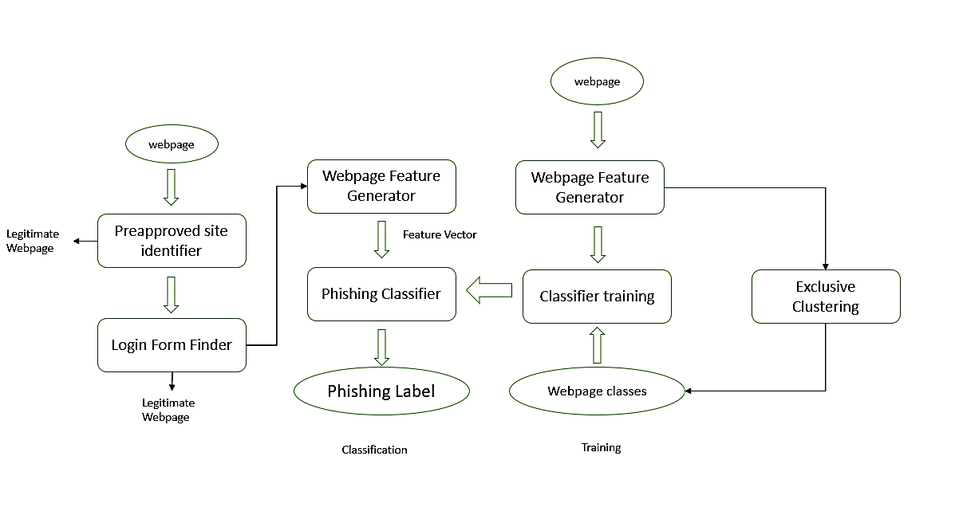
SYSTEM ARCHITECTURE
Fig:Detection of Phishing Website using SVM & Light GBM

Slide 10
MODULES
Data Collection and Preprocessing:Collect labeled datasets of phishing and legitimate URLs, clean and normalize data, handle missing values, and encode non-numeric attributes for machine learning compatibility.
Feature Extraction and Engineering:Extract key features (e.g., URL length, HTTPS usage, SSL status, domain age) and normalize numerical values to improve model performance.
Model Training with SVM:Train a LightGBM model with optimized hyperparameters to efficiently classify phishing URLs using gradient boosting and decision trees.
Model Training with LightGBM:Train an SVM model with various kernel functions to maximize the separation between phishing and legitimate sites, ensuring high accuracy in high-dimensional data.
Evaluation and Model Selection:Assess models using accuracy, precision, recall, and F1-score. Optimize for speed and accuracy, considering ensemble approaches for better performance.
Deployment:Integrate the trained model into real-time applications (browser extensions, cybersecurity tools) for on-demand phishing detection.
Monitoring and Maintenance:Continuously track performance, retrain with new data, and adapt to emerging phishing tactics to maintain high detection accuracy.

Slide 11
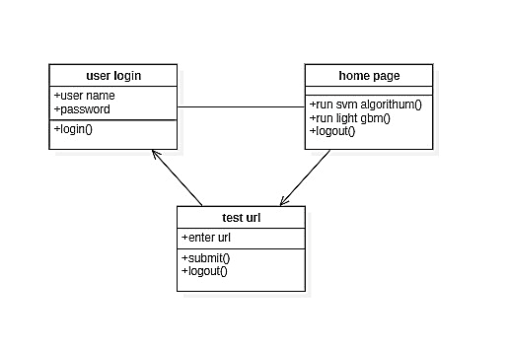
CLASS DIAGRAM

Slide 12
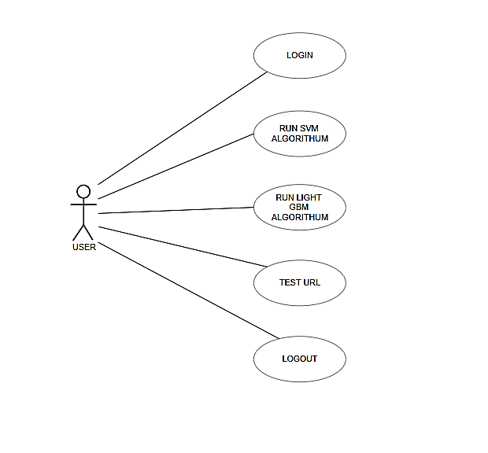
USECASE DIAGRAM

Slide 13
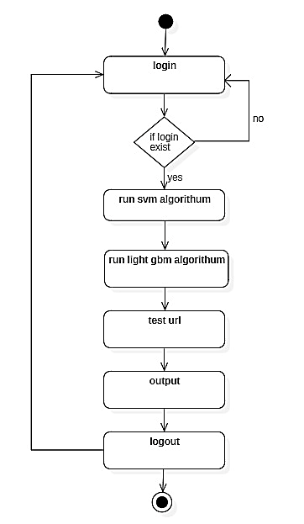
ACTIVITY DIAGRAM

Slide 14
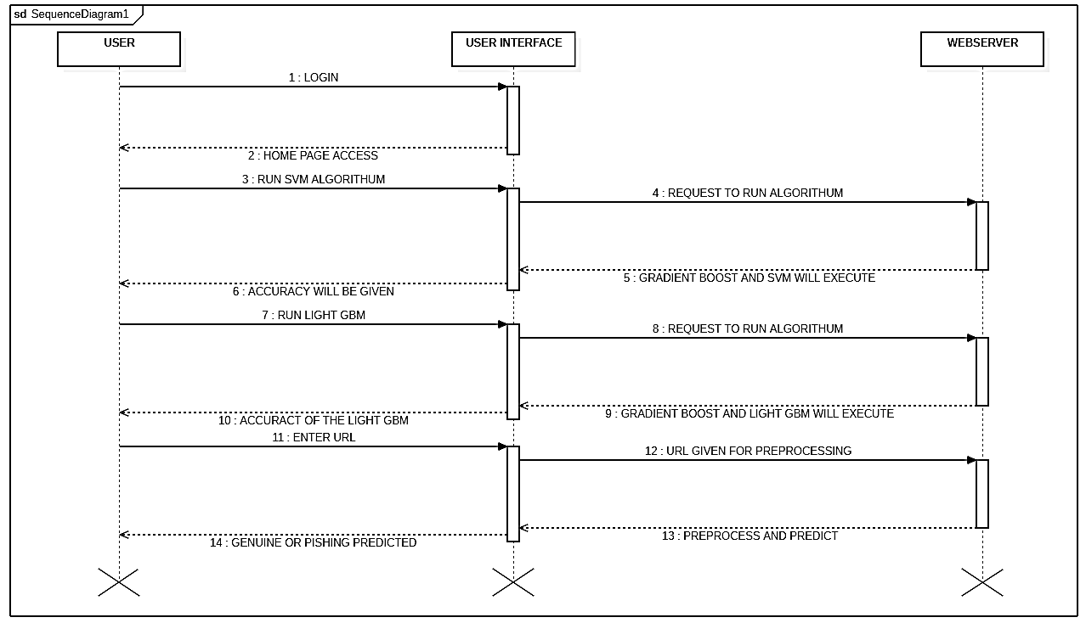
SEQUENCE DIAGRAM

Slide 15
SAMPLE CODE
from django.shortcuts import render
from django.template import RequestContext
from django.contrib import messages
from django.http import HttpResponse
import os
import pandas as pd
import numpy as np
import matplotlib.pyplot as plt
import pickle
from sklearn.model_selection import train_test_split
from sklearn.feature_extraction.text import TfidfVectorizer
from sklearn.metrics import accuracy_score
from sklearn import svm
from lightgbm import LGBMClassifier

Slide 16
from sklearn.metrics import precision_score
from sklearn.metrics import recall_score
from sklearn.metrics import f1_score
from sklearn.metrics import confusion_matrix
import seaborn as sns
global precision, recall, fscore, accuracy
X = np.load("model/X.txt.npy")
Y = np.load("model/Y.txt.npy")
indices = np.arange(X.shape[0])
np.random.shuffle(indices)
X = X[indices]
Y = Y[indices]
with open('model/tfidf.txt', 'rb') as file:
tfidf = pickle.load(file)
file.close()

Slide 17
X = tfidf.fit_transform(X).toarray()
print(X.shape)
X_train, X_test, y_train, y_test = train_test_split(X, Y, test_size=0.2)
if os.path.exists('model/svm.txt'):
with open('model/svm.txt', 'rb') as file:
svm_cls = pickle.load(file)
file.close()
else:
svm_cls = svm.SVC()
svm_cls.fit(X_train, y_train)
with open('model/svm.txt', 'wb') as file:
pickle.dump(svm_cls, file)
file.close()
if os.path.exists('model/lgbm.txt'):
with open('model/lgbm.txt', 'rb') as file:

Slide 18
lgbm_cls = pickle.load(file)
file.close()
else:
lgbm_cls = LGBMClassifier()
lgbm_cls.fit(X_train, y_train)
with open('model/lgbm.txt', 'wb') as file:
pickle.dump(lgbm_cls, file)
file.close()
with open('model/rf.txt', 'rb') as file:
rf_cls = pickle.load(file)
file.close()
def RunSVM(request):
if request.method == 'GET':
global precision, recall, fscore, accuracy
global X_train, X_test, y_train, y_test
precision = []

Slide 19
accuracy = []
fscore = []
recall = []
predict = svm_cls.predict(X_test)
acc = accuracy_score(y_test,predict)*100
p = precision_score(y_test,predict,average='macro') * 100
r = recall_score(y_test,predict,average='macro') * 100
f = f1_score(y_test,predict,average='macro') * 100
precision.append(p)
recall.append(r)
fscore.append(f)
accuracy.append(acc)
output = ""
output+='<tr><td><font size="" color="black">SVM</td>'
output+='<td><font size="" color="black">'+str(accuracy[0])+'</td>'
output+='<td><font size="" color="black">'+str(precision[0])+'</td>'

Slide 20
output+='<td><font size="" color="black">'+str(recall[0])+'</td>'
output+='<td><font size="" color="black">'+str(fscore[0])+'</td>'
LABELS = ['Normal URL','Phishing URL']
conf_matrix = confusion_matrix(y_test, predict)
plt.figure(figsize =(6, 6))
ax = sns.heatmap(conf_matrix, xticklabels = LABELS, yticklabels = LABELS, annot = True, cmap="viridis" ,fmt ="g");
ax.set_ylim([0,2])
plt.title("SVM Confusion matrix")
plt.ylabel('True class')
plt.xlabel('Predicted class')
plt.show()
context= {'data':output}
return render(request, 'ViewOutput.html', context)

Slide 21
def RunLGBM(request):
if request.method == 'GET':
global precision, recall, fscore, accuracy
global X_train, X_test, y_train, y_test
predict = lgbm_cls.predict(X_test)
acc = accuracy_score(y_test,predict)*100
p = precision_score(y_test,predict,average='macro') * 100
r = recall_score(y_test,predict,average='macro') * 100
f = f1_score(y_test,predict,average='macro') * 100
precision.append(p)
recall.append(r)
fscore.append(f)
accuracy.append(acc)
output = ""
output+='<tr><td><font size="" color="black">SVM</td>'

Slide 22
output+='<td><font size="" color="black">'+str(accuracy[0])+'</td>'
output+='<td><font size="" color="black">'+str(precision[0])+'</td>'
output+='<td><font size="" color="black">'+str(recall[0])+'</td>'
output+='<td><font size="" color="black">'+str(fscore[0])+'</td>'
output+='<tr><td><font size="" color="black">Light GBM</td>'
output+='<td><font size="" color="black">'+str(accuracy[1])+'</td>'
output+='<td><font size="" color="black">'+str(precision[1])+'</td>'
output+='<td><font size="" color="black">'+str(recall[1])+'</td>'
output+='<td><font size="" color="black">'+str(fscore[1])+'</td>'
LABELS = ['Normal URL','Phishing URL']
conf_matrix = confusion_matrix(y_test, predict)
plt.figure(figsize =(6, 6))
ax = sns.heatmap(conf_matrix, xticklabels = LABELS, yticklabels = LABELS, annot = True, cmap="viridis" ,fmt ="g");

Slide 23
ax.set_ylim([0,2])
plt.title("Decision Tree Confusion matrix")
plt.ylabel('True class')
plt.xlabel('Predicted class')
plt.show()
context= {'data':output}
return render(request, 'ViewOutput.html', context)
def getData(arr):
data = ""
for i in range(len(arr)):
arr[i] = arr[i].strip()
if len(arr[i]) > 0:
data += arr[i]+" "
return data.strip()

Slide 24
def PredictAction(request):
if request.method == 'POST':
global rf_cls, tfidf
url_input = request.POST.get('t1', False)
test = []
arr = url_input.split("/")
if len(arr) > 0:
data = getData(arr)
print(data)
test.append(data)
test = tfidf.transform(test).toarray()
print(test)
print(test.shape)
predict = rf_cls.predict(test)
print(predict)
predict = predict[0]

Slide 25
output = ""
if predict == 0:
output = url_input+" Given URL Predicted as Genuine"
if predict == 1:
output = url_input+" PHISHING Detected in Given URL"
context= {'data':output}
return render(request, 'Predict.html', context)
else:
context= {'data':"Entered URL is not valid"}
return render(request, 'Predict.html', context)
def index(request):
if request.method == 'GET':
return render(request, 'index.html', {})
def Predict(request):
if request.method == 'GET':
return render(request, 'Predict.html', {})

Slide 26
def AdminLogin(request):
if request.method == 'GET':
return render(request, 'AdminLogin.html', {})
def AdminLoginAction(request):
if request.method == 'POST':
global userid
user = request.POST.get('t1', False)
password = request.POST.get('t2', False)
if user == "admin" and password == "admin":
context= {'data':'Welcome '+user}
return render(request, 'AdminScreen.html', context)
else:
context= {'data':'Invalid Login'}
return render(request, 'AdminLogin.html', context)

Slide 27
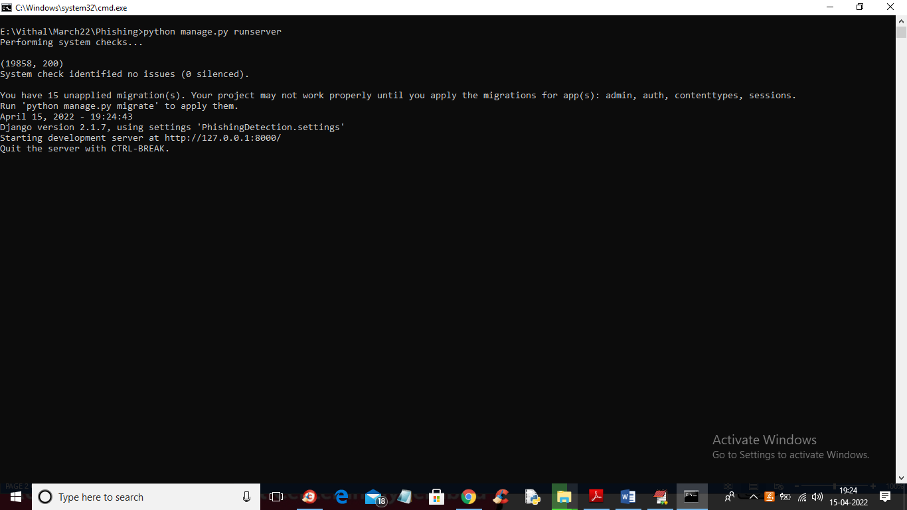
RESULTS
In above screen WAMP webserver started and now open browser and enter URL http://127.0.0.1:8000/index.html and press enter key to get below output

Slide 28
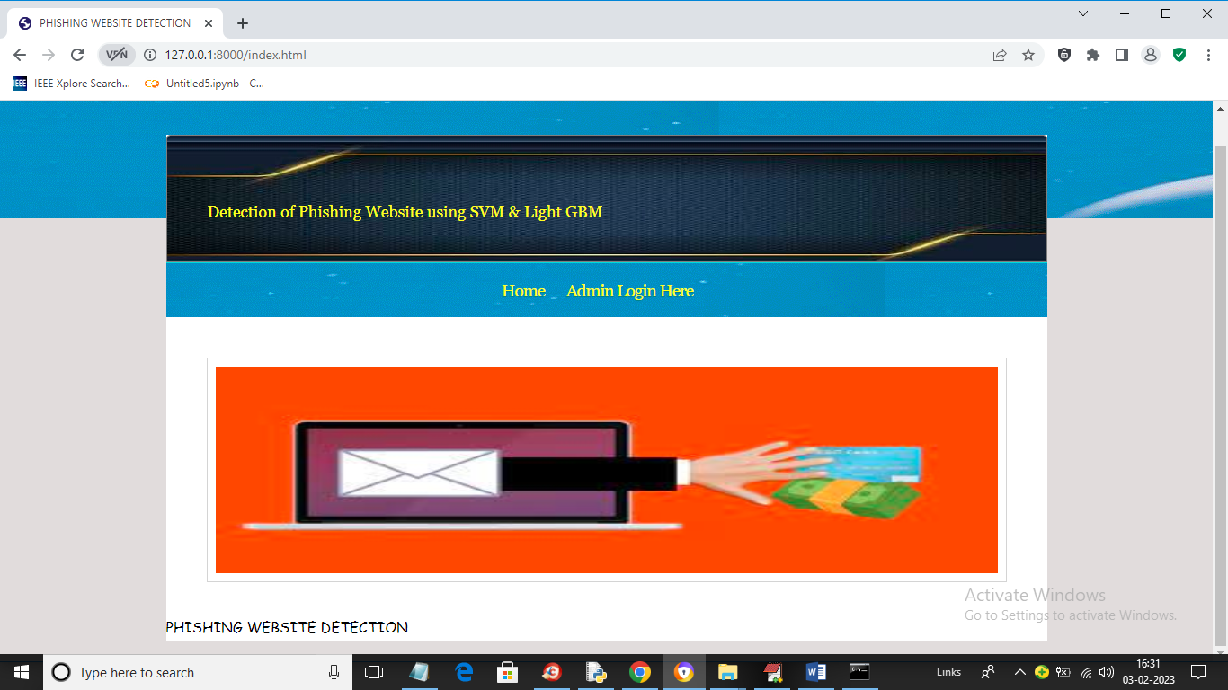
In above screen click on ‘Admin Login Here’ link to get below login screen

Slide 29
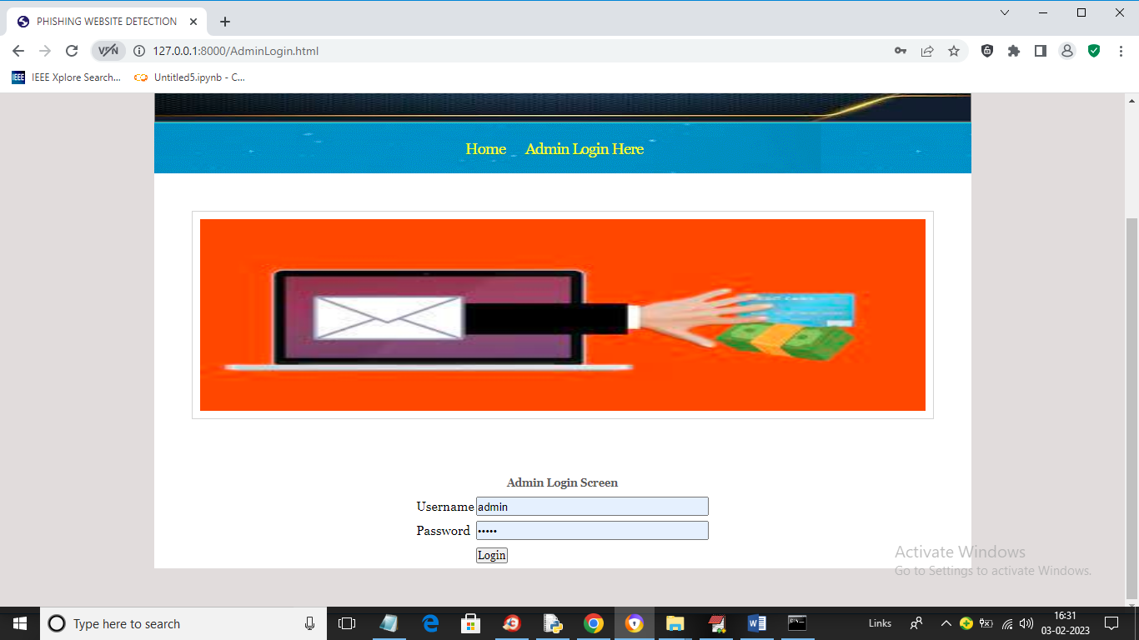
In above screen enter username and password as ‘admin’ and ‘admin’ and then press button to get below output

Slide 30
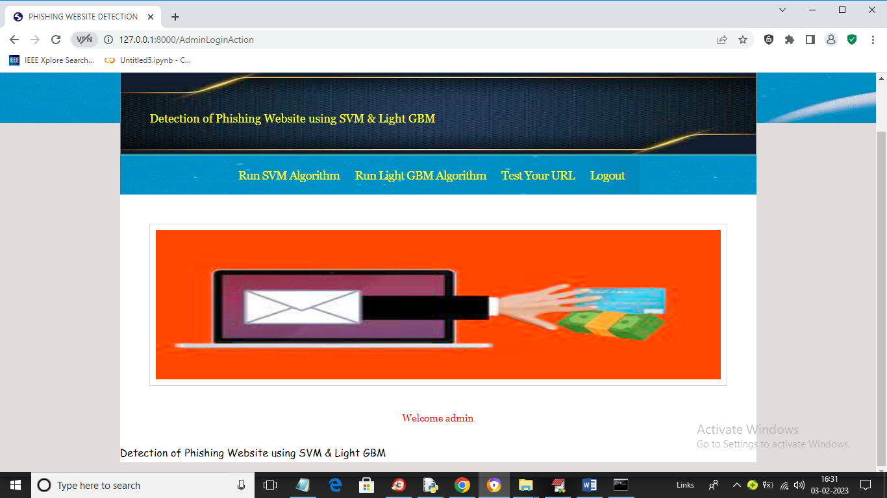
In above screen click on ‘Run SVM Algorithm’ link to train SVM algorithm and get below output

Slide 31
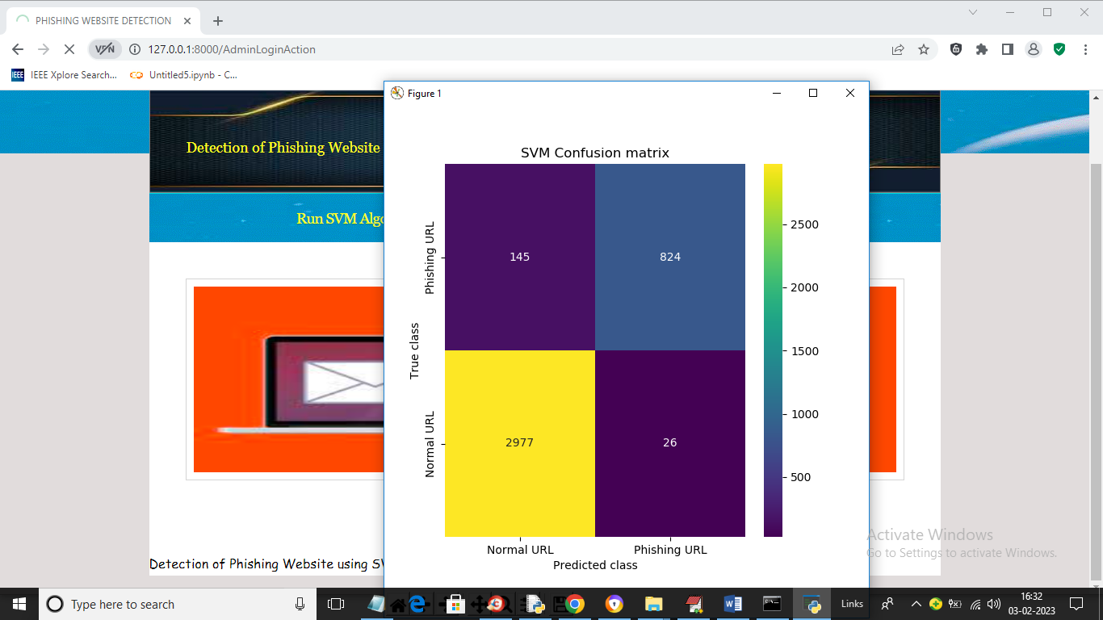
In above screen we can see SVM confusion matrix where x-axis represents predicted class and y-axis represents TRUE class and we can see SVM predict 2977 records correctly as NORMAL and only 145 are incorrect prediction and it predict 824 records as PHISHING URL and only 26 are incorrect prediction and now close above graph to get below output

Slide 32
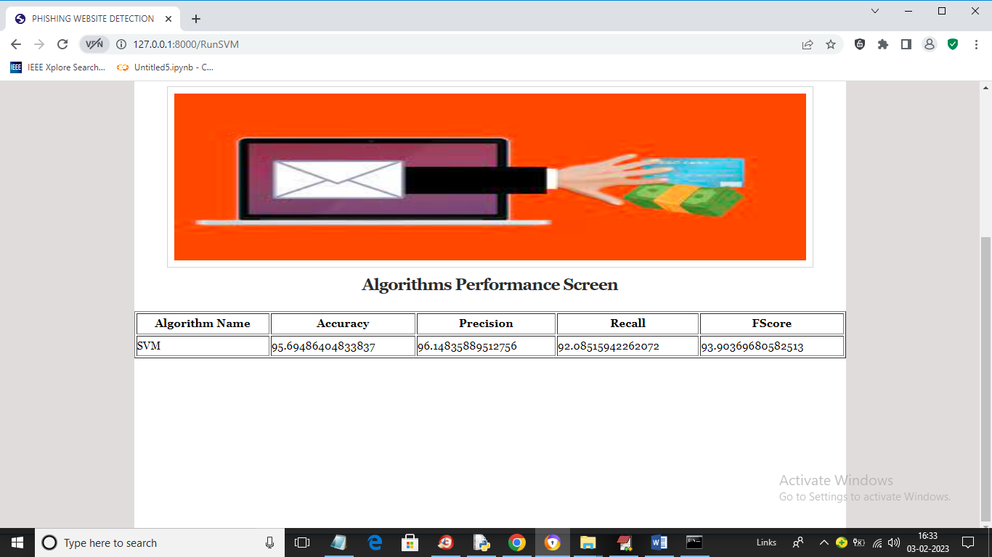
In above screen with SVM we got 95% accuracy and now click on ‘Run Light GBM Algorithm’ link to get below output

Slide 33
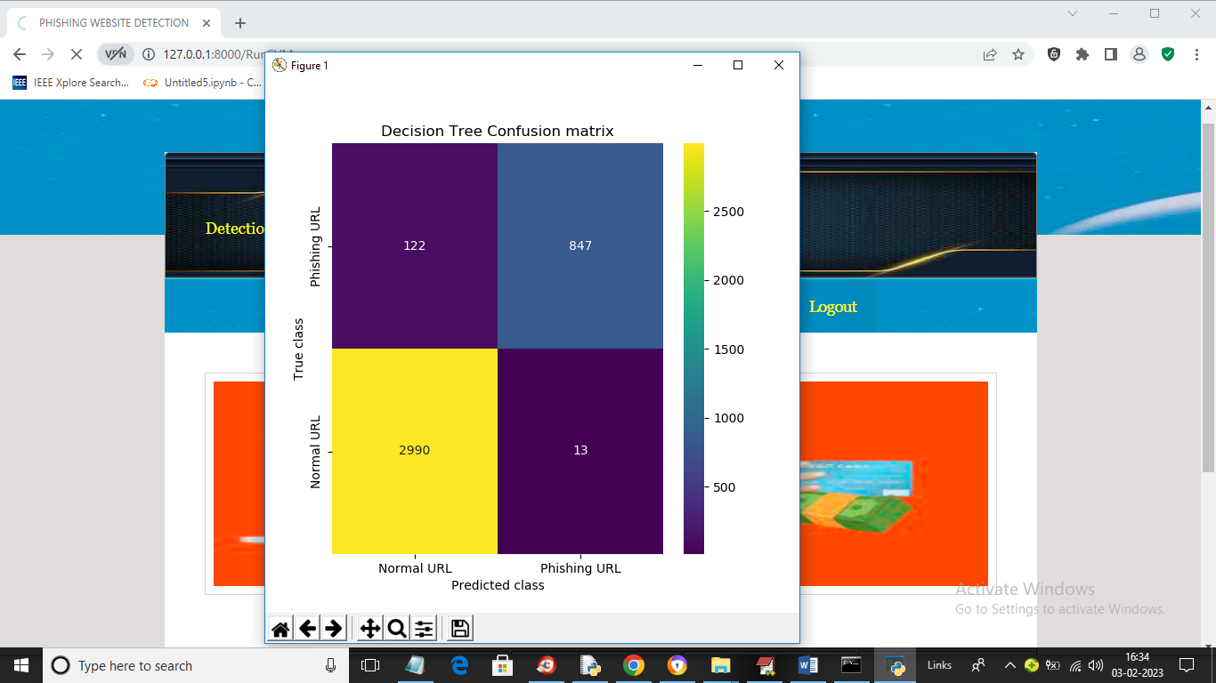
In above screen we can see Decision Tree confusion matrix graph and now close above graph to get below output

Slide 34
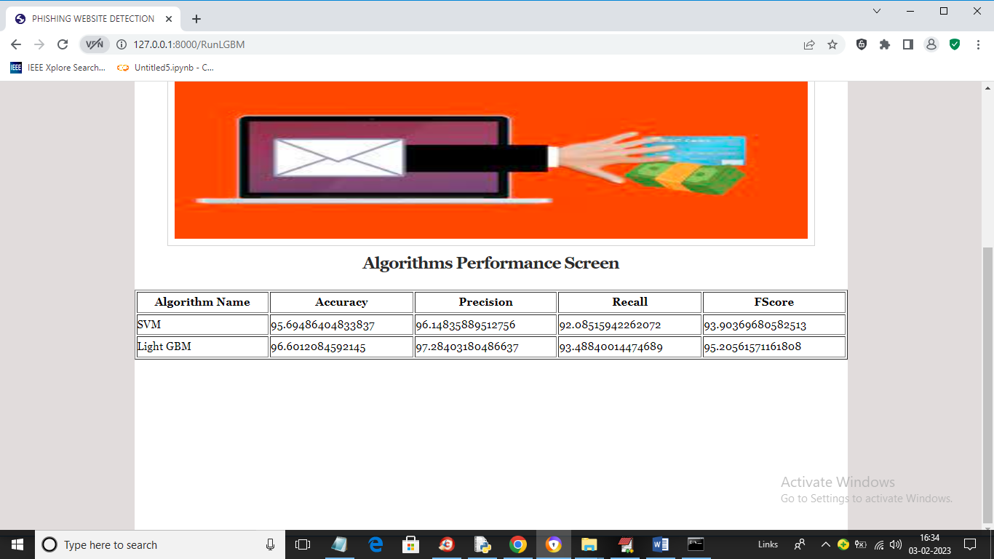
In above screen with Light GBM also we got 96% accuracy and now click on ‘Test Your URL’ link to get below screen

Slide 35
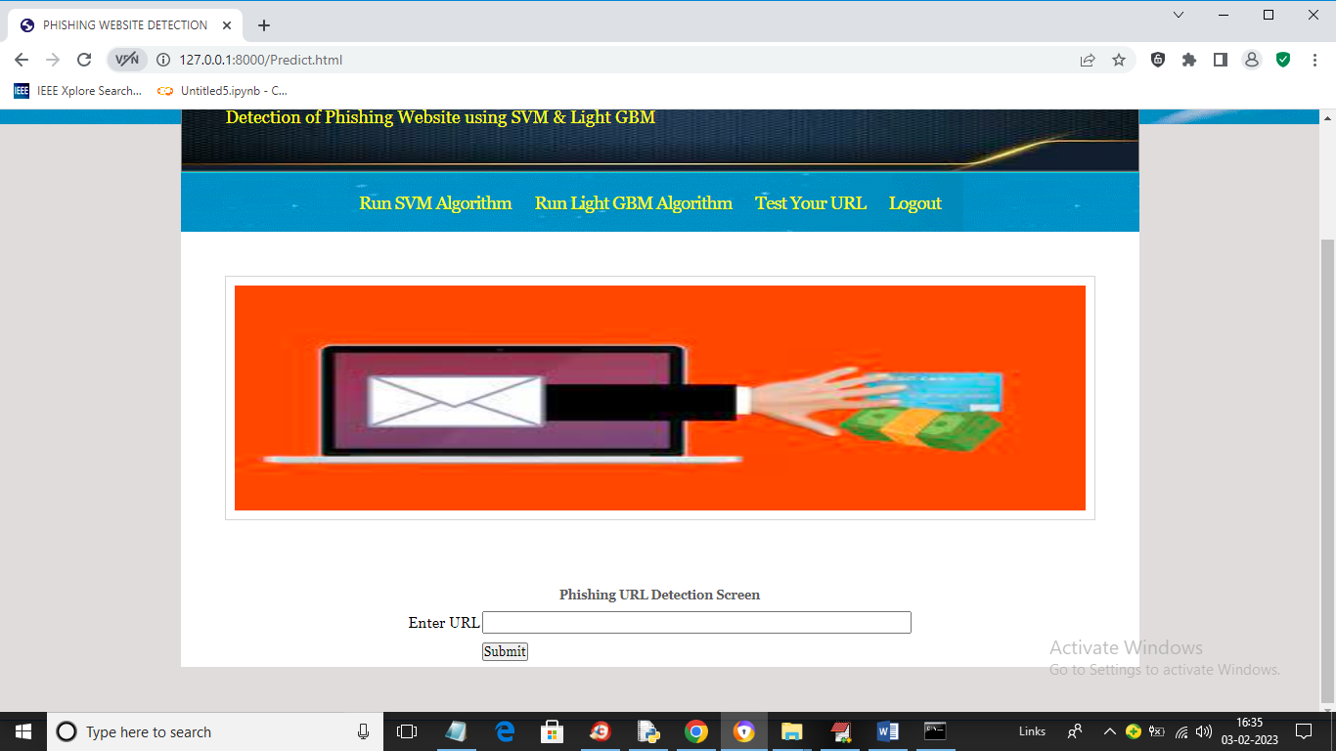
In above screen enter any URL and then press button and then Light GBM will predict whether that URL IS normal or phishing

Slide 36

In above screen I entered URL as https://mail.google.com and then press button to get below output

Slide 37
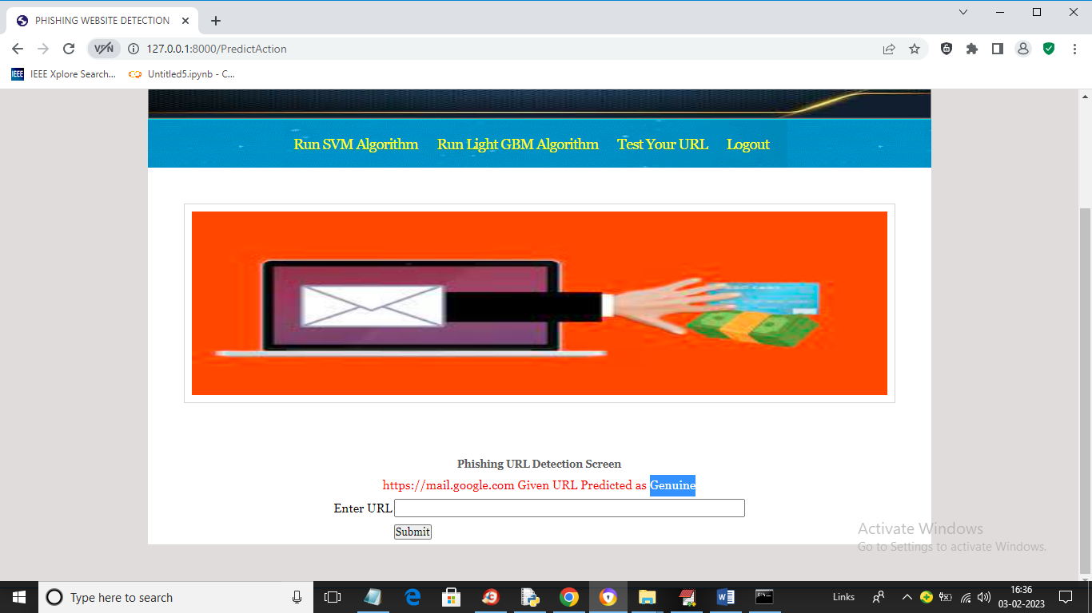
In above screen in blue colour text we can see given URL predicted as GENUINE (normal) and now test other URL. Similarly now I will enter Google.com in below screen

Slide 38
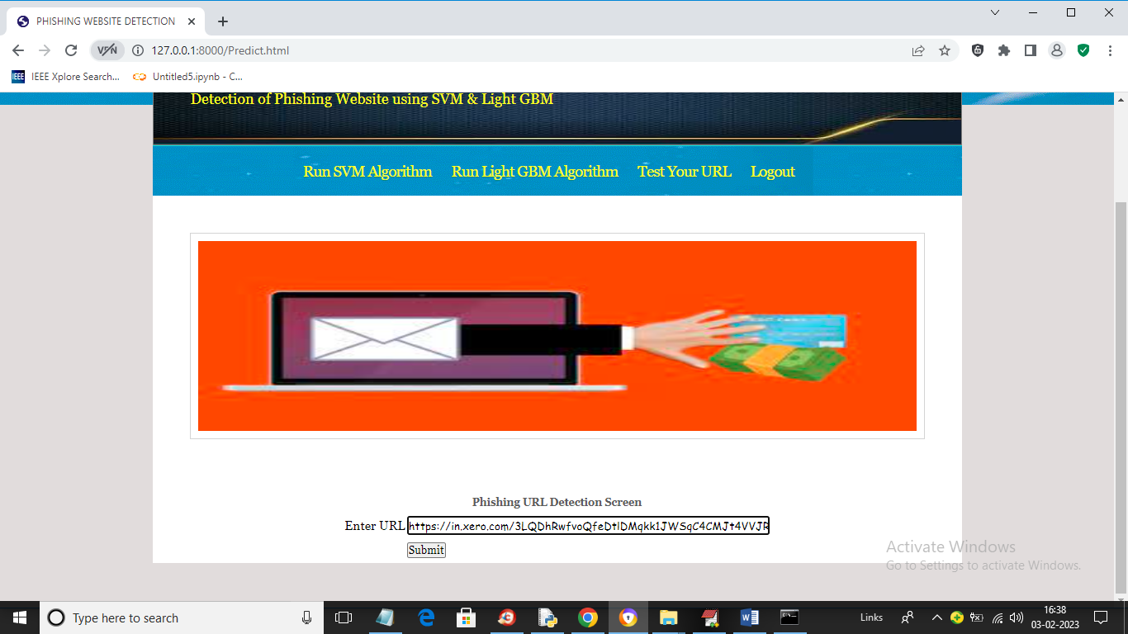
In the above screen int the text field entered phishing url

Slide 39
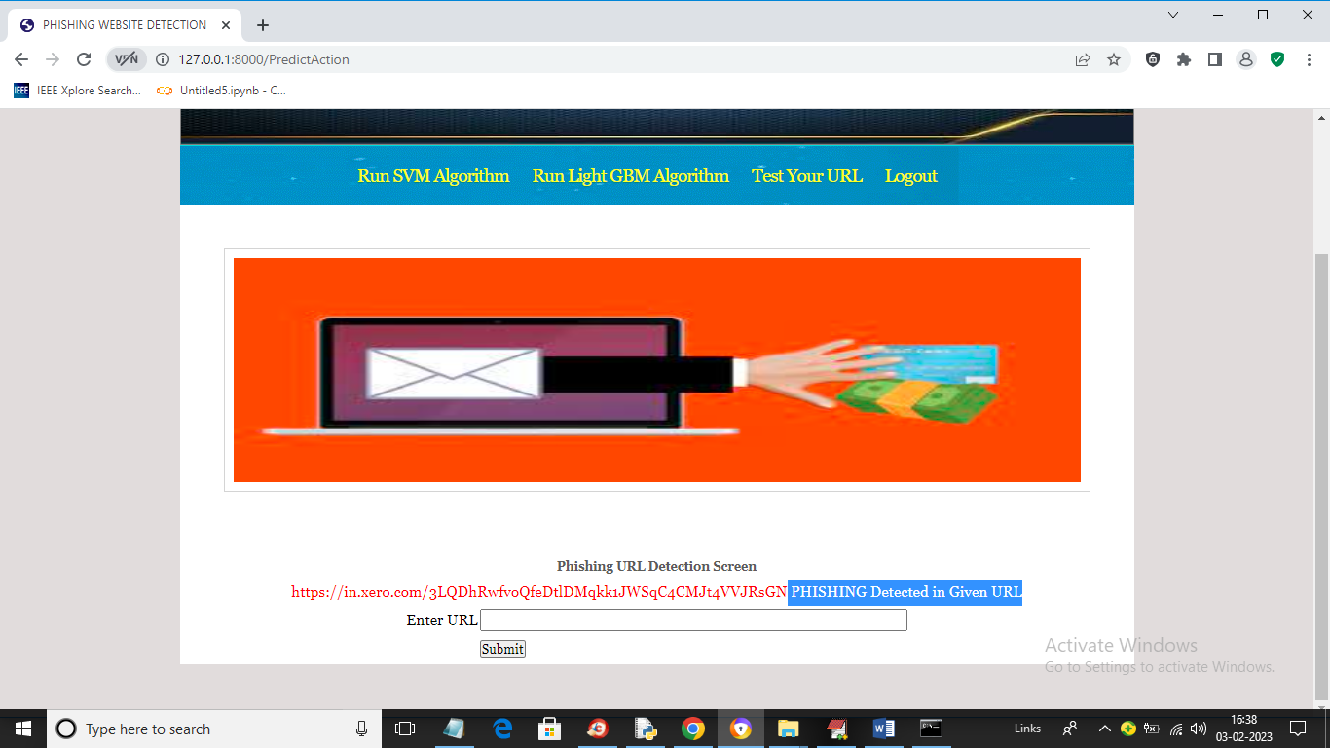
In above screen in blue colour text we can see application detected PHISHING in given URL and similarly you can enter any URL and detect it as NORMAL or phishing

Slide 40
CONCLUSION
The proposed phishing detection system effectively enhances security by leveraging machine learning techniques to identify malicious URLs with high accuracy. By integrating LightGBM, Support Vector Machine (SVM), and Random Forest (RF), the system improves classification performance and reduces false positives. The use of domain name-based features and TF-IDF vectorization allows the model to detect phishing attempts more efficiently, even for newly generated URLs. Implemented using Django, the system provides a real-time, webbased detection platform, making it scalable and user-friendly. Overall, the proposed approach offers a fast, automated, and reliable solution for detecting phishing websites, helping to strengthen online security against evolving cyber threats.

Slide 41
FUTURE SCOPE
Privacy-Preserving Feature Extraction : Domain name features are obtained without accessing user privacy-related data like network traffic.
Character Feature Extraction : Uses a local feature-extraction algorithm to analyze domain names without requiring external data.
Information Feature Extraction : Requires website access or external queries to retrieve domain-related information.
Two Categories of Features : Domain name features are classified into:
Character-Based Features : Extracted from the domain name structure without visiting the website.
Information-Based Features : Obtained from the corresponding website or external query sources.

Slide 42
REFERENCES
Ms. Sophiya Shikalgar, Mrs. Swati Narwane (2019), Detecting of URL based Phishing Attack using Machine Learning. (vol. 8 Issue 11, November – 2019)
Rashmi Karnik, Dr. Gayathri M Bhandari, Support Vector Machine Based Malware and Phishing Website Detection.
Arun Kulkarni, Leonard L. Brown, III2 , Phishing Websites Detection using Machine Learning (vol. 10, No. 7,2019)
R. Kiruthiga, D. Akila, Phishing Websites Detection using Machine Learning.
Ademola Philip Abidoye, Boniface Kabaso, Hybrid Machine Learning: A Tool to detect Phishing Attacks in Communication Networks. (vol. 11 No. 6,2020)
Andrei Butnaru, Alexios Mylonas and Nikolaos Pitropakis, Article Towards Lightweight URL-Based Phishing Detection.13 June 2021

Slide 43
THANK YOU

